Slide 1
Baseband and Passband

Slide 2
Examples

Slide 3
Example

Slide 4
Example

Slide 5


Parseval’s Identity
Inner product can be computed in either time or frequency domain
Important implication: energy can be computed in time or frequency domain

Slide 6
Example

Slide 7
Homework
Problems: 2.6, 2.8, 2.9, 2.11 and 2.12

Slide 8
Baseband and Passband Signals/Channels
Channels often approximated as LTI systems
Signal passes through channel, and then noise is added
Channels allocated/described typically in terms of frequency bands
Signals have to be designed for the corresponding frequency band
Baseband channels/signals
Energy concentrated in a frequency band around DC
Passband channels/signals
Energy concentrated in a frequency band away from DC
Unified treatment of baseband and passband systems
Complex baseband representation of passband systems

Slide 9

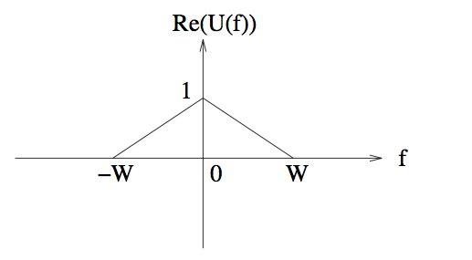
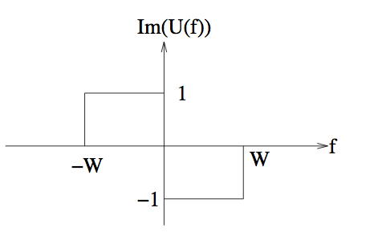
Baseband Signals
Baseband signals have energy/power concentrated in a band around DC.
Above: Real baseband signal of bandwidth W (U(f) obeys conjugate symmetry).
Note that |U(f)| is symmetric for a real baseband signal.)
For communication over a physical baseband channel, we consider physical (real-valued)
baseband signals.
For communication over a physical passband channel, we consider complex-valued baseband signals which provide a convenient mathematical representation for the corresponding passband signals.

Slide 10


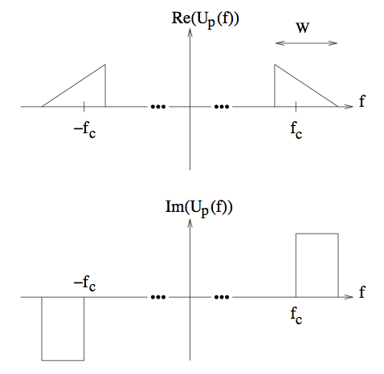
Passband Signals
Passband signals have energy/power concentrated in a band away from DC.
Carrier
frequency
Bandwidth
Passband signal of bandwidth W
We only consider physical (real-valued) passband signals, hence their spectra
always obey conjugate symmetry

Slide 11
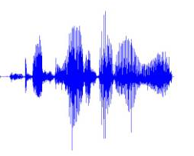
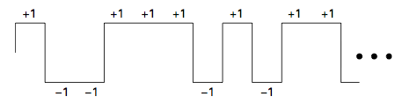
Examples of baseband signals
Speech, audio are baseband signals
Two-level digital signal is baseband
But we often want to send such signals over a passband channel
(e.g., a 20 MHz WiFi channel at 2.4 GHz). Need to understand how passband
signals are structured in order to accomplish this.

Slide 12

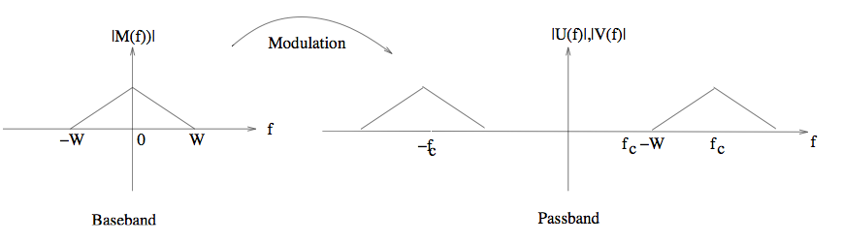
Modulation: Baseband to Passband
Consider a real-valued baseband message signal m(t)
Modulation: Translate to passband by multiplying by a sinusoid
or
Should be
positive
Carrier frequency should be bigger than the message bandwidth to keep away from DC

Slide 13

I and Q components
Can modulate separately using cosine and sine of carrier
Sinusoids are rapidly varying but predictable (contain no info)
Passband
signal
In-phase (I)
component
Quadrature (Q)
component
Real baseband signals
(contain all the information)
We now know that we can start from two real baseband signals and
get a passband signal by I/Q modulation.
How do we get back the I and Q components from the passband signal?
Can any passband signal be decomposed into I and Q components?

Slide 14
I and Q Components
u_{c}(t) and u_{s}(t) are real baseband signals of bandwidth at most W, with f_{c} > W.
The signal
u_{c}(t) is called the in-phase (or I) component, and u_{s}(t) is called the quadrature (or Q) component.
The negative sign for the Q term is a standard convention.
Since the sinusoidal terms are entirely predictable once we specify f_{c}, all information in the passband signal up must be contained in the I and Q components. Modulation for a passband channel therefore corresponds to choosing a method of encoding information into the I and Q components of the transmitted signal, while demodulation corresponds to extracting this information from the received passband signal.
In order to accomplish modulation and demodulation, we must be able to upconvert from baseband to passband, and downconvert from passband to baseband.

Slide 15


Band limitation need not be strict
Example: (Approximately) passband signal
I and Q components are timelimited, hence cannot be strictly bandlimited
But frequency content is concentrated around DC, well away from f_{c} = 150.

Slide 16
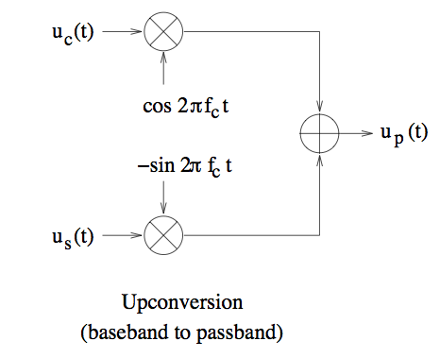
Upconversion: baseband to passband
Block diagram follows directly from
equation defining the modulated signal
Happens at the transmitter
In practice, may do upconversion in multiple stages
Must worry about adhering to spectral masks, controlling nonlinearities

Slide 17
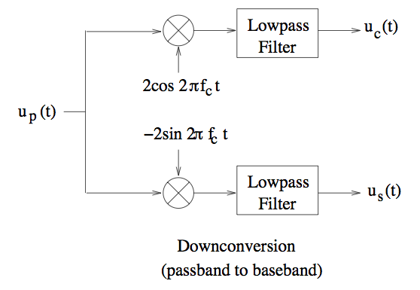
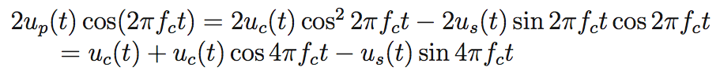
Downconversion: Passband to Baseband
Works as long as receiver
is coherent (phase and
frequency of copy of carrier
at receiver same as that of
incoming signal)
Recovering the I component (similar derivation for Q component):
terms rejected by LPF

Slide 18
Downconversion
The Q component u_{s}(t) by lowpass filtering −2u_{p}(t) sin(2πf_{c}t). Implementation of these operations could, in practice, be done in multiple stages, and requires careful analog circuit design.
Passband signal structure:
Can the I and Q components be chosen independent of each other?
The I and Q components provide two parallel, orthogonal “channels” for encoding information.
Orthogonality of I and Q channels:
The passband waveform a_{p}(t) = u_{c}(t) cos(2πf_{c}t) corresponding to the I component, and the passband waveform b_{p}(t) = u_{s}(t) sin(2πf_{c}t) corresponding to the Q component, are orthogonal.

Slide 19



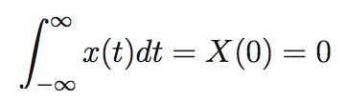

I and Q “channels” are orthogonal (can send info in parallel on these channels)
Any real baseband waveforms
with bandwidth less than the
carrier frequency
Then the passband waveforms a_{p} and b_{p} are orthogonal
Proof:
is passband at 2f_{c}(why?)
(zero DC value)
Why?
is baseband with BW at most equal to sum of bws of u_{c} and u_{s} < 2f_{c}

Slide 20
Passband Signal
Since a passband signal up is equivalent to a pair of real-valued baseband waveforms (u_{c}, u_{s}), passband modulation is often called two-dimensional modulation.
The representation in terms of I and Q components corresponds to rectangular coordinates (the “cosine axis” and the “sine axis”). The passband waveform can also be represented using polar coordinates.

Slide 21
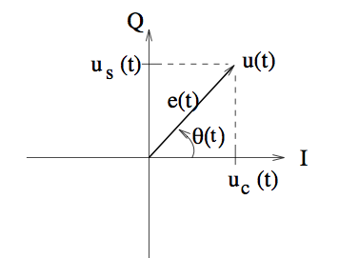
Passband modulation is 2-dimensional
Passband signal can be mapped to a pair of real baseband signals
That is, passband modulation is two-dimensional. Can also plot it on complex plane.
Complex envelope
Q component
Envelope
Phase
I component
Three equivalent representations of the passband signal
Rectangular coordinates: I and Q
Polar coordinates: Envelope and phase
Complex number: Complex envelope

Slide 22


Complex Envelope
Each representation
of a complex number
corresponds to a
time domain expression
for the passband signal

Slide 23


Time domain expressions for a passband signal
In terms of
I and Q components
In terms of
envelope and phase
In terms of
complex envelope
Starting from one representation,
can derive the rest based on
the relations depicted in
the figure

Slide 24
Passband Signal
The complex baseband representation corresponds to subtracting out the rapid, but predictable, phase variation due to the fixed reference frequency f_{c}, and then considering the much slower amplitude and phase variations induced by baseband modulation.
Since the phase variation due to f_{c} is predictable, it cannot convey any information. Thus, all the information in a passband signal is contained in its complex envelope.
We can define the complex baseband representation of a passband signal using an arbitrary frequency reference f_{c} (and can also vary the phase reference), as long as we satisfy f_{c} > W, where W is the bandwidth.

Slide 25
Reference Frequency/Phase
The complex baseband representations for two different references can be transformed.
u_{p}(t) = u_{c1}(t) cos(2πf₁t+θ₁)−u_{s1}(t) sin(2πf₁t+θ₁) = u_{c2}(t) cos(2πf₂t+θ₂)−u_{s2}(t) sin(2πf₂t+θ₂)

Slide 26
Change of reference frequency/phase

Slide 27
Frequency Domain Relationships

Slide 29
Frequency Domain Relationships
Since C∗(−f) is the complex conjugated version of C(f), flipped around the origin, it has frequency content in the band of negative frequencies [−fc −W,−fc +W] around −fc, which does not include DC.
Substituting C(f) by U(f − fc), we obtain the passband spectrum in terms of the complex baseband spectrum:
Given the spectrum U_{p}(f) for a real-valued passband signal u_{p}(t), C(f) can be constructed as a scaled version of U⁺_{p} (f) = U_{p}(f)I_{[0,∞)}(f), the positive frequency part of U_{p}(f):

Slide 30
Complex Envelope

Slide 31
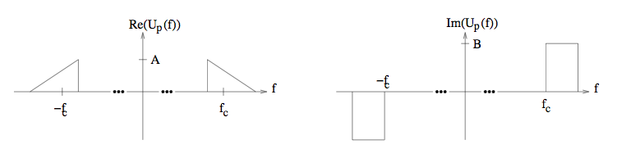
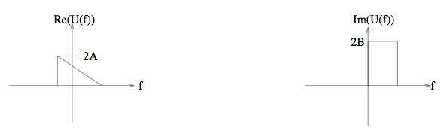
Frequency domain construction of complex envelope
PASSBAND SIGNAL
Move to left by f_{c}
Move to left by f_{c}
Scale by 2
Scale by 2
Throw away negative
frequencies part
Throw away negative
frequencies part
COMPLEX ENVELOPE
Let’s check that this is consistent with the time domain relationship.

Slide 32



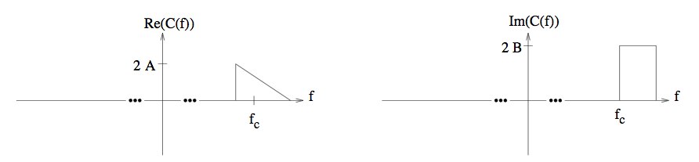
Why the frequency domain construction works, I

Slide 33

Why the frequency domain construction works, II
We see that
We already know
This gives

Slide 34


I and Q components in frequency domain
I and Q in time domain
I and Q in frequency domain

Slide 35
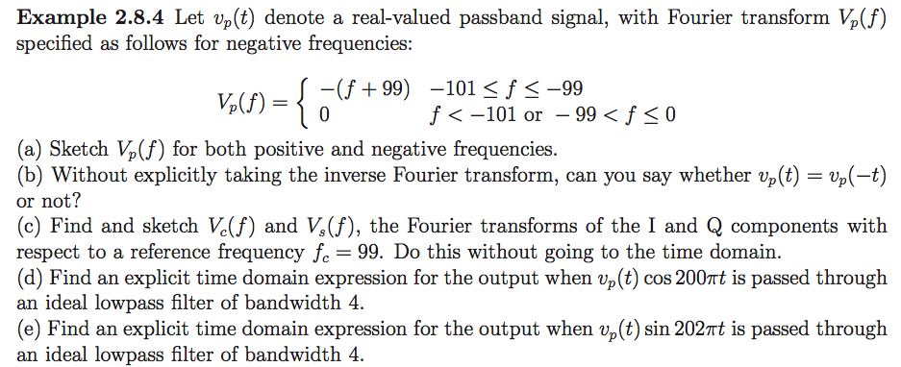
Exercise

Slide 36
Modern transceiver architectures are based on complex baseband
Modern transceivers work with the complex envelope rather than with the passband signal
Complex baseband signals can be represented accurately by samples at a reasonable sampling rate
Inexpensive to perform complicated digital signal processing (DSP) on the samples: Moore’s law scaling
This architecture has been responsible for economies of scale in cellular and WiFi
All the action is in complex baseband for a typical wireless transceiver
Channel Encoding
Modulation
Spectral Shaping
RF signal
Filtering
Synchronization
Demodulation
Decoding
Upconversion
Dnconversion
Complex
envelope
Complex
envelope
DSP-based
processing
DSP-based
processing
TRANSMITTER
RECEIVER

Slide 37
Most transceiver operations can be performed in complex baseband
Filtering
Carrier frequency/phase correction
Coherent and noncoherent reception

Slide 38
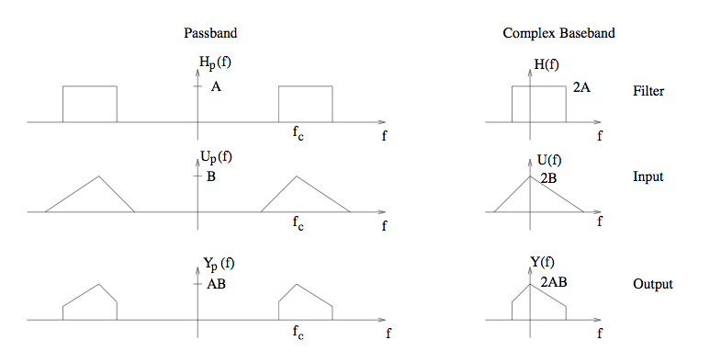
Passband filtering is equivalent to complex baseband filtering
s_{p}(t)
h_{p}(t)
y_{p}(t)
EQUIVALENT TO
s(t)
h(t)
y(t)
(except for a scale factor of 2)
Proof by pictures:

Slide 39


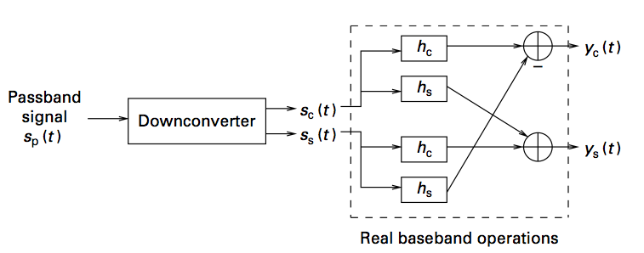
Filtering in complex baseband
Complex-valued convolution to implement equivalent of passband filtering operation
Requires four real-valued convolutions:
Downconverter can use sloppy analog passband filter
Sophisticated filtering can be implemented in baseband (scalar factors not shown)

Slide 40






Modeling phase offset in complex baseband
Time varying phase can model both phase and frequency offset

Slide 41
Exercise
Find the convolution of the two passband waveforms
and

Slide 42
Complex baseband representation
Any real-valued passband signal can be represented by a baseband signal which is in general complex-valued. This is called its complex envelope, or complex baseband representation.
The complex envelope carries all the information in the passband signal
Passband filtering operations can be equivalently performed in complex baseband
Two-dimensional representation of complex envelope
Cartesian coordinates: A pair of real-valued baseband waveforms called the in-phase (I) and quadrature (Q) components
Polar coordinates: Envelope and phase waveforms
Most of the sophisticated signal processing action in modern transceivers happens in complex baseband

Slide 43


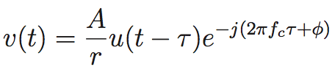
Propagation basics
Transmitted passband signal
Transmitted complex baseband signal
Received signal for a single ray/path of length r and delay τ

Slide 44
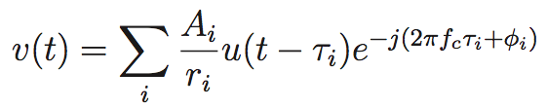
Complex envelope for multiple paths
Depend on angle of incidence, scattering surface characteristics,
carrier wavelength, etc.
We will not model these in detail
Two key approaches to channel modeling
Ray tracing: when detailed models of propagation environment are available
Statistical: developed based on measurement campaigns, then draw channels at
random from statistical model for performance evaluation of candidate designs

Slide 45
Example

